Slide 1
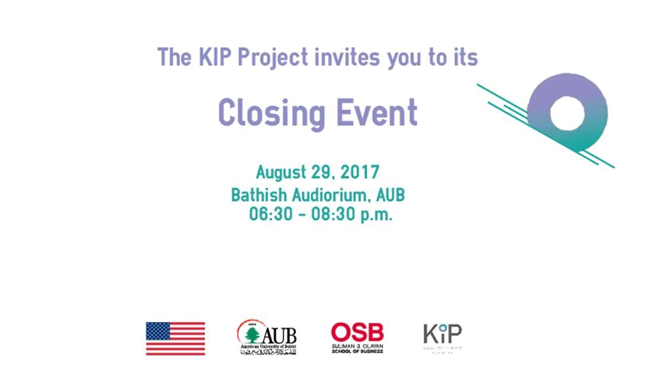


Welcome
this is PowerPoint Presentation Template.
Scroll to se more
Notes:
Representative of the Ministry of State for Women’s Affairs and Advisor to the Prime Minister on Women’s Affairs, Ms Abir Chebaro.
Dean Harvey, xxxx, xxx, Distinguished quests, students and colleagues
Good evening and welcome to the American University of Beirut.
On behalf of the KIP team and our fantastic Partners, it gives me great pleasure to welcome you to the Closing event of the Knowledge is Power (KIP) Project,
Thank you for choosing to be with us on this fine evening to celebrate with us our KIP Journey. I see many familiar faces in the audience, representatives of the many departments, faculties, universities, organizations and trailblazing businesses who were integral to each and every step of the project.
We have been blessed and honored to have many of you (and many more) join hands with KIP to augment the complex and multifaceted conversation on issues related to gender and sexuality in Lebanon.
From the outset, the KIP Team would like to thank:
the U.S. Department of State and the Secretary of State’s Office of Global Women’s Issues, our generous donors, for the federal assistance award that made this day possible.
We would also like to thank President Khuri, Dean Harvey, Dean Cheikh
and the many offices at AUB who made the project possible.
Without the support and the hard work of the staff at the
Office of the Comptrollers,
OGC,
office of Procurement and contracts administration,
Office of financial planning,
Office of communications,
Department of human resources,
Office of IT
Housing department
And the many other listed in the credits of our documentary
Our vision would not have come to light.

Slide 2


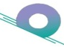
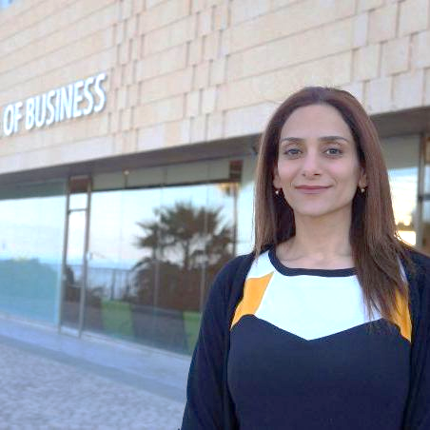
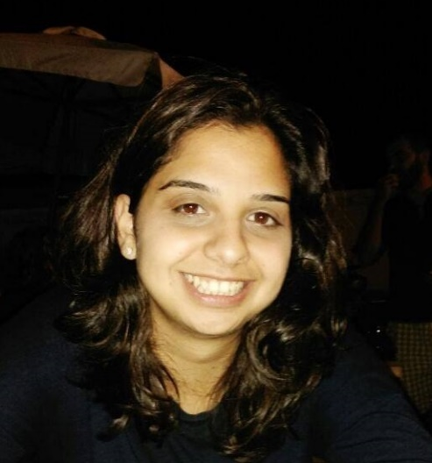
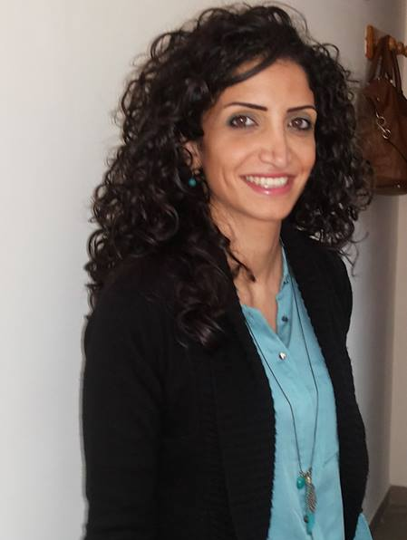
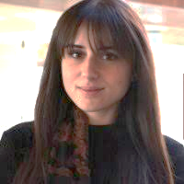
Meet our team
Knowledge in Power (KIP) Project. Only through knowledge sharing and dialogue can we make positive change forward.
Charlotte Karam
Zeina Mhaidly
Heather Jaber
Aimee Ghanem
Project Director
Project Coordinator
Communications Coordinator
Conference Coordinator

Slide 3
Little about KIP community
Building networks to create common spaces for knowledge exchange and shared actions for change
KIP Advisory board.
Fida Afiouni – Women and Careers
Diana Abou Abbas – Sexual Health Beverly Metcalfe – Gender and Develp
Fadia Hoteit – Education Zeina Abdelkhalik – Governance
Sawsan Abdulrahim – Health Joumana Halabi – Education
Trudi Hodges – Discrimination Evelyne Karam - Education
Tarek Zeidan – Human Rights Lina Abirafeh – Discrimination and GBV
Dima Jamali – CSR and HRM Sally Abikhalil – Advocacy
Asma Zein – Entrepreneurship Marguerite Helou – Politics
Jad Melki – Media Nadine Saba – Humanitarian Assistance
Youmna Makhlouf – Law Nadia Cheikh – Women in Islam
Fida Kanaan – Executive Education Fida Kanaan – Executive Education
Zeina Abla – Econ Empowerment
Zeina Mezher – Advocacy/ Migrant Workers
KIP partners.
Women in Front
Joelle Rizkallah
Nada Anid
Arab Foundation for Freedom and Equality
Georges Azzi
Nour Nasr
.

Slide 4


Original Mandate
A two-year AUB-OSB project funded through a federal assistance award from the U.S. Department of State .
Phase 1:
Data gathering and knowledge generation
Phase 2:
Creating interaction opportunities and sharing
  Mapping what is being done
  Building bridges between civil society, academia and between public, private, and legal sectors
  Identifying gaps through conversations during private roundtables
  Social Media campaigns
  KIP communications and student
  outreach activities
  KIP multidisciplinary conference
  KIP Training Workshops

Slide 5
Phase 1
Understanding and exploring

Slide 6

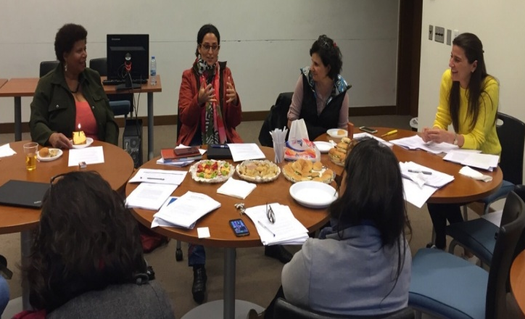

5 Private
Roundtables
Phase 1 activities
Feminist Reading Circles
15 Funded Studies
  Education
  Economic Empowerment
  Health & Well-being
  Politics
  Legal &Civil Rights
“Let’s Talk” Interview series
“Why Talk” quote series
-Women in science
-Feminist epistemology
-Women and economic empowerment
Shed light on reasons why its important
Notes:
First phase we wanted to LEARN and BUILD COMMUNITY ------ roundtables

Slide 7

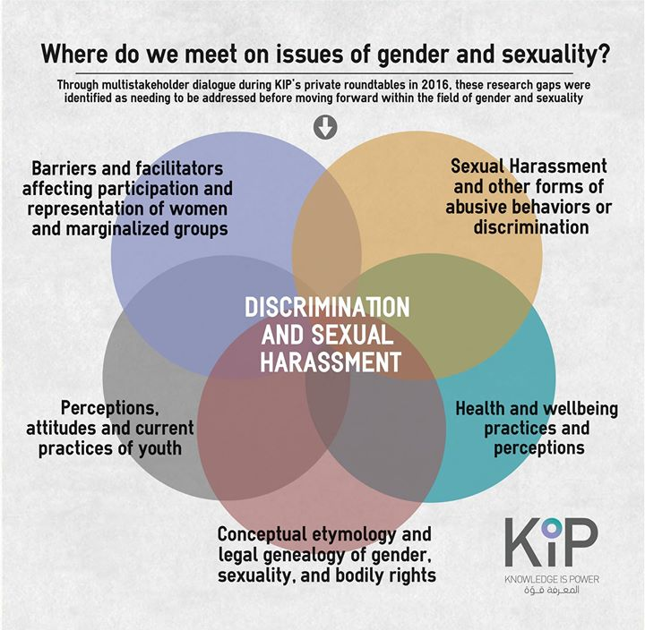
Emergent themes
Notes:
Series of knowledge gaps and research questions
Call for papers--- 15 studies…. Also feminist redoing circles augmenting nd eploring further
ONE THEME ACROSS ALL--- SH

Slide 8
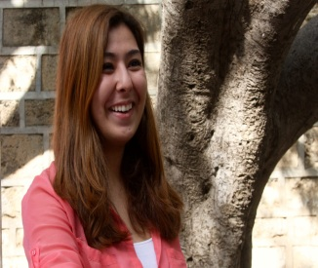
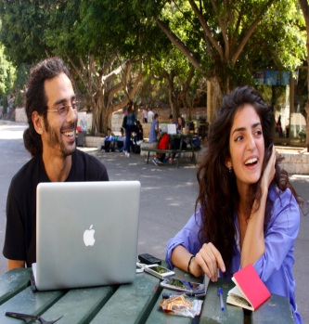
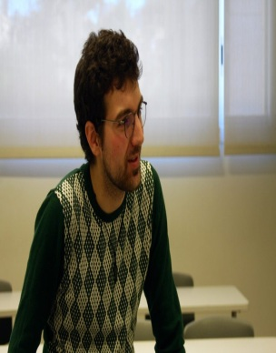
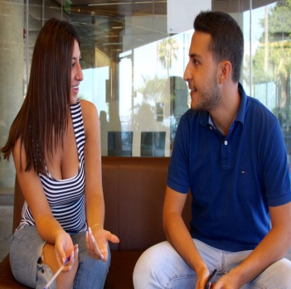
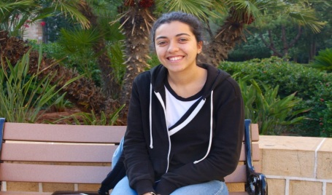
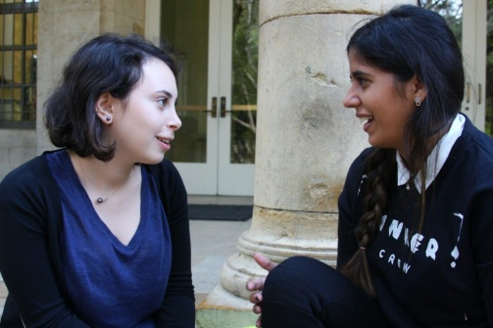
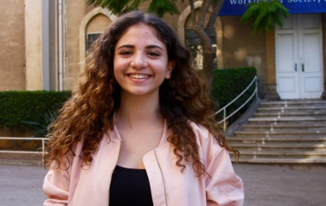
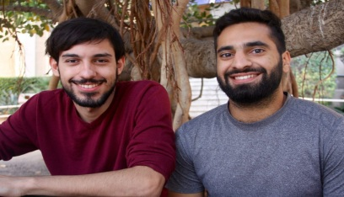
5 Private
Roundtables
Phase 1 activities
Feminist Reading Circles
15 Funded Studies
  Education
  Economic Empowerment
  Health & Well-being
  Politics
  Legal &Civil Rights
“Let’s Talk” Interview series
“Why Talk” quote series
-Women in science
-Feminist epistemology
-Women and economic empowerment
  9 Documentation
  6 Research
Encouraging dialogue
Shed light on reasons why its important

Slide 9
INGO
Academic
Building more KIP community
Medical
Medical
Syndicates
NGO
Business
Government
Building networks to create common spaces for knowledge exchange and shared actions for change
Social Enterprise
March
The Legal Agenda
Executive Magazine
The A-Project
LEBMASH
USEK
Wiley
AUB
ILO
AFE
Lebanon support
Ministry of Ed. Higher Ed
IRC
Lebanese Psychological Assoc.
Bahithat
BLC Bank
KAFA
BalamandUni
Lebanese
Chamber of Commerce
IWSAW
Lebanese Uni
UC
DAVIS
Akkar Network Development
LAU
HELEM
Women In Front
UNICEF
EHMU
AM. UNI
CAIRO
AUBMC
Order Of Nurses
LLWB
Deloitte
NCLW
Anti-Racism Movement
USJ
ARC EN CIEL
University of Manchester
Marsa
AM. UNI SHARJAH
Ministry of Social Affairs
Dark Side TV and Film Production
Women In Parliament
LAU
University for seniors
Teach For Lebanon
Gender &
Sexuality Resource Center
ABAAD
Title IX Office-AUB
BIRZEIT
Notes:
Through these activities our community was being build with connecting others and ourselves

Slide 10
Phase 2
Outreach & Public awareness campaign

Slide 11
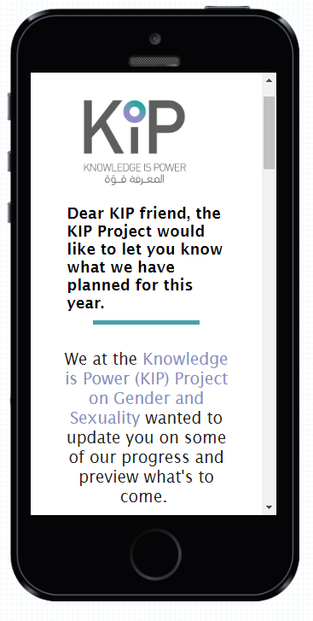
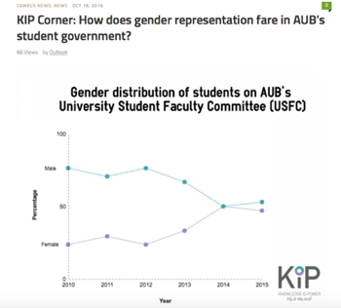
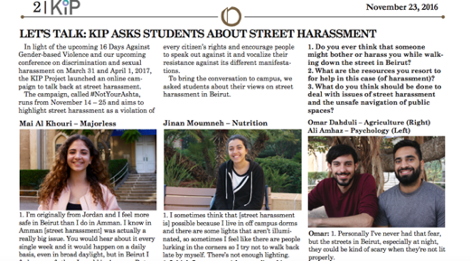
KIP Corner in Outlook, AUB’s student newspaper
KIP monthly newsletter

Slide 12
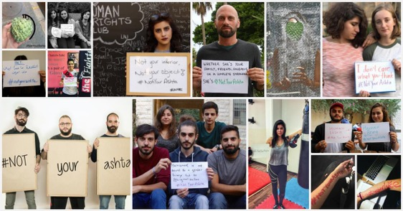
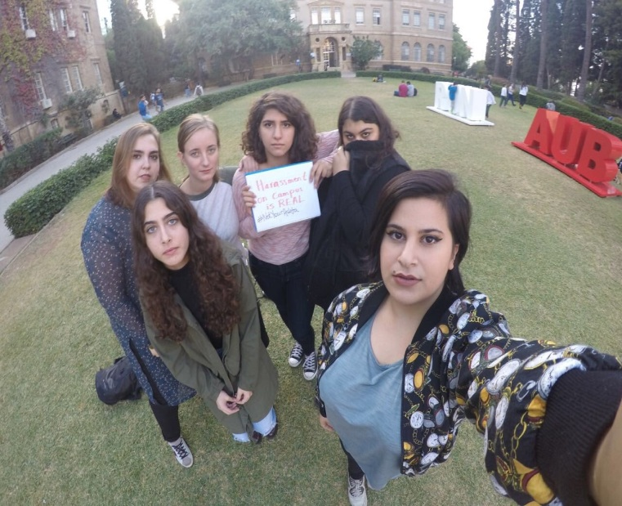
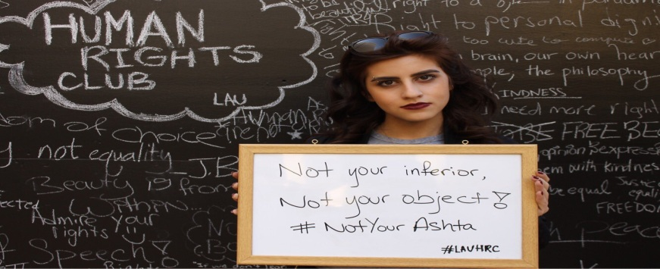

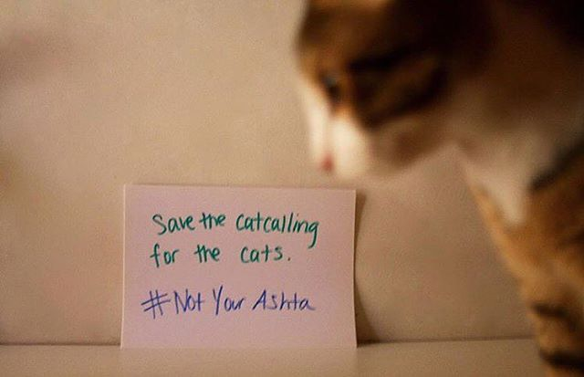
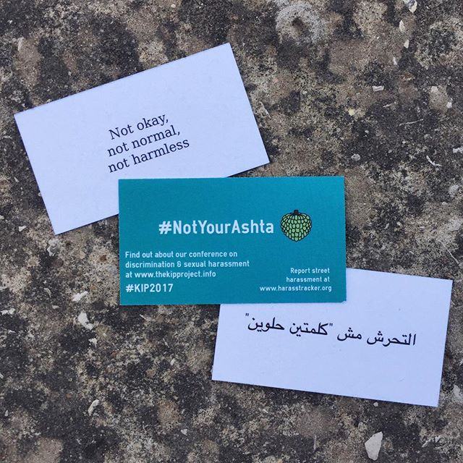
#Not Your Ashta public awareness campaign

Slide 13
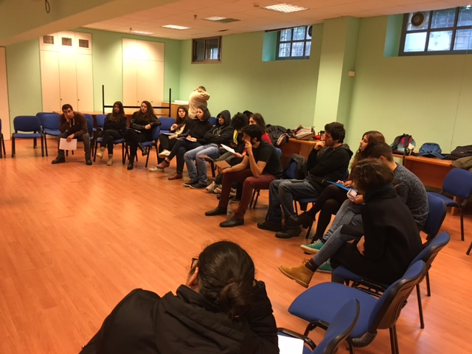
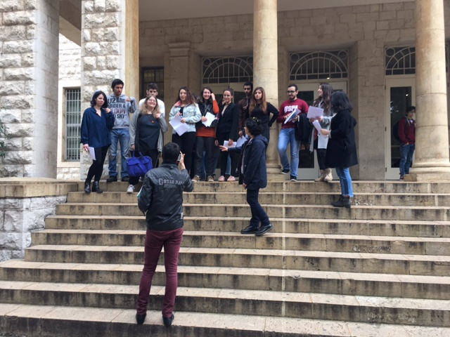
KIP collaboration with the AUB theater initiative
(directed by Sahar Assaf and Robert Myers)
Mr Sani Abdul Baki's Stage Acting Workshop (Theater 221)
Students soapbox performances of powerful narratives around Discrimination.
Notes:
We tried to be creative in our partnerships to get students involved

Slide 14
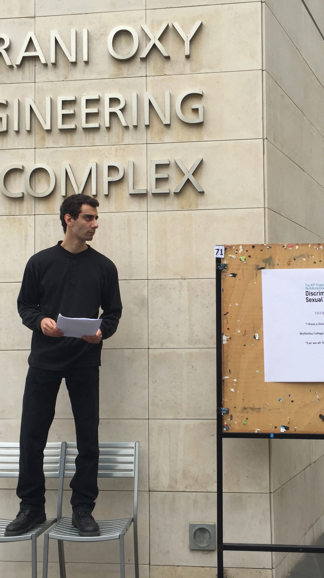
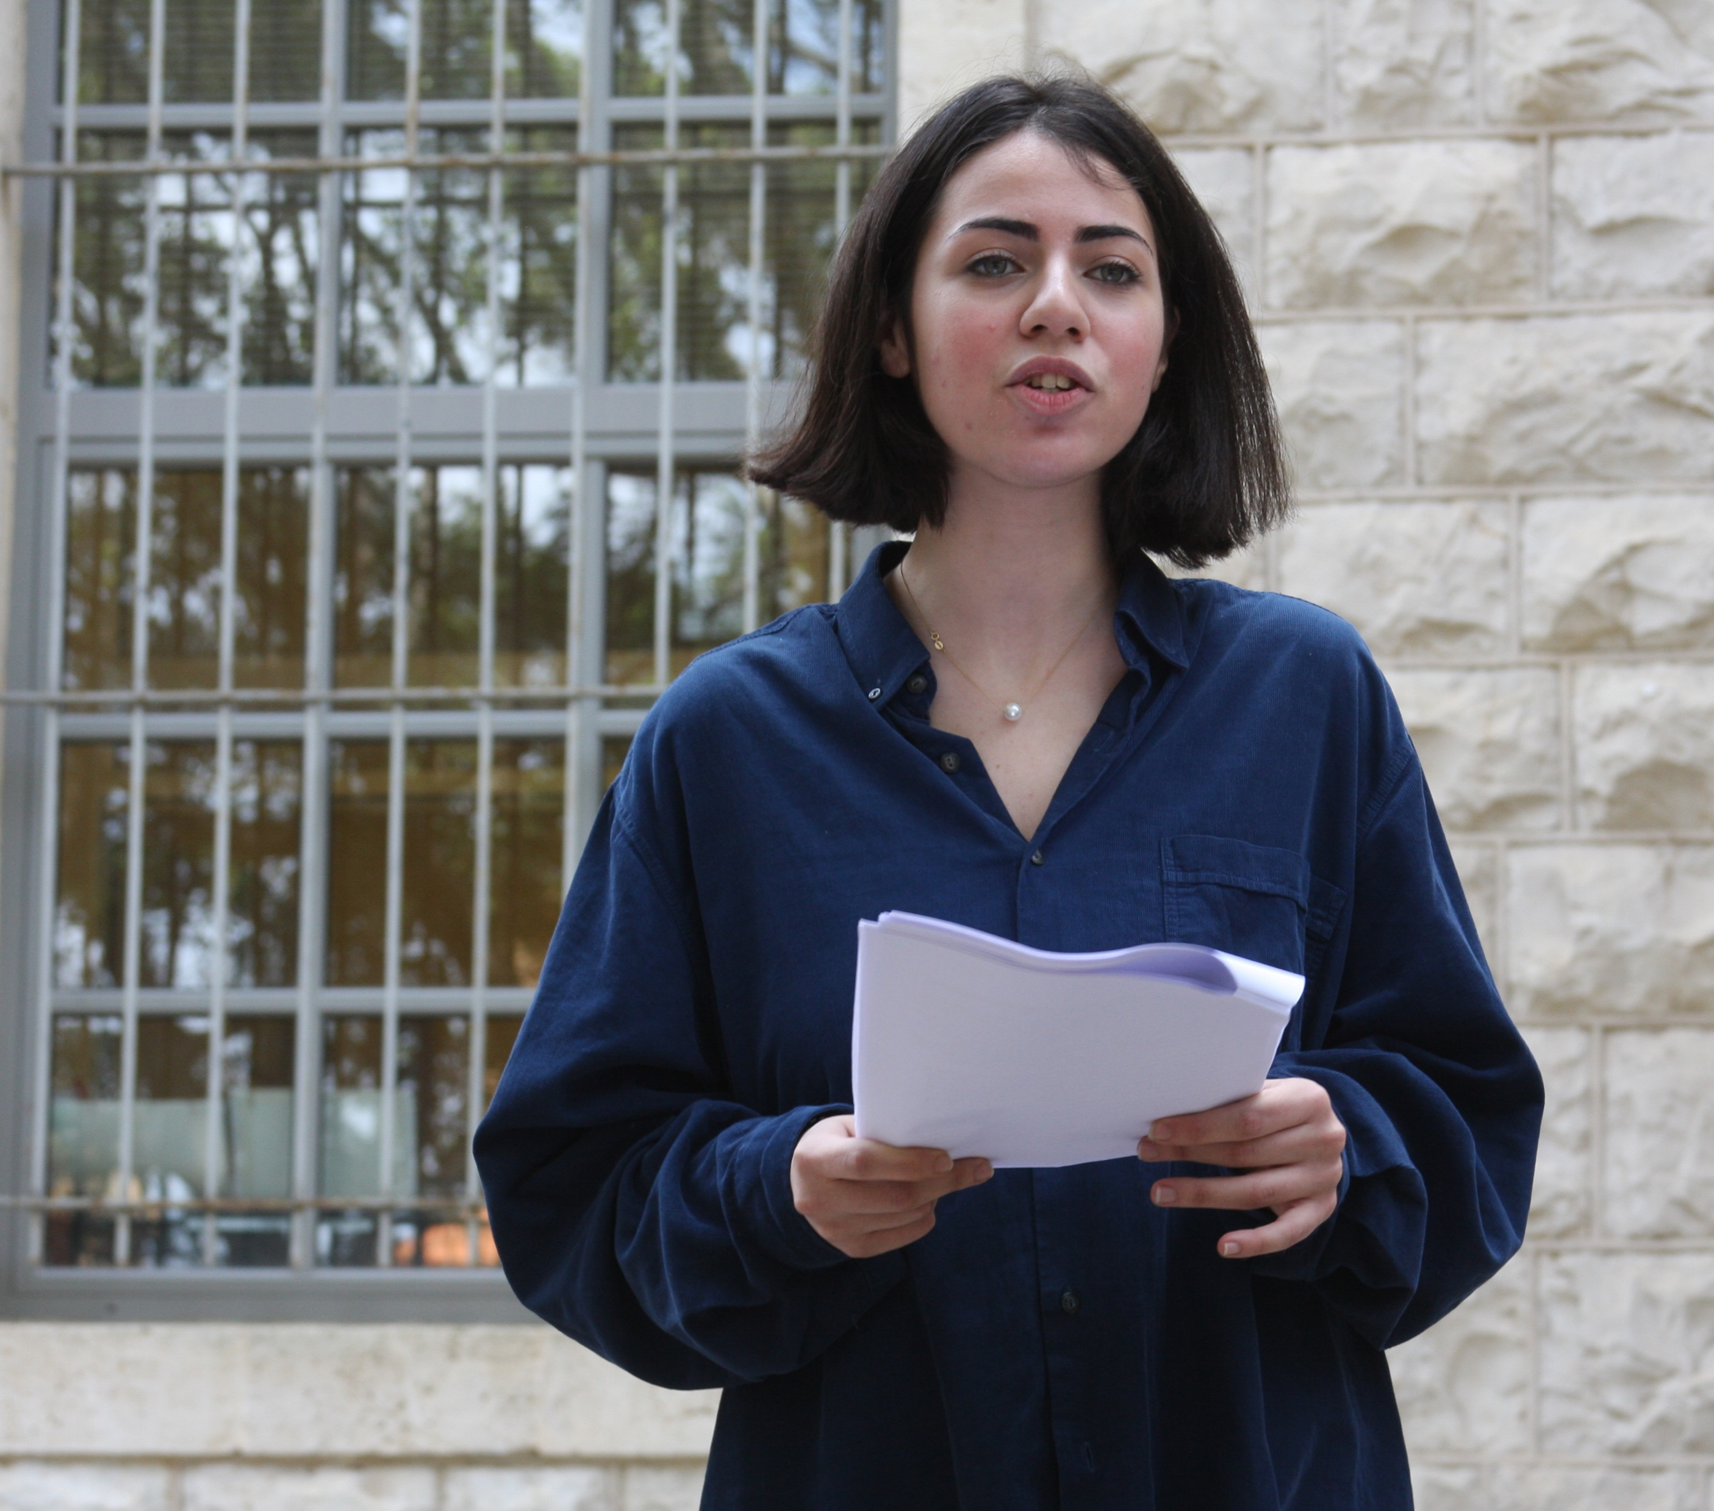

Slide 15
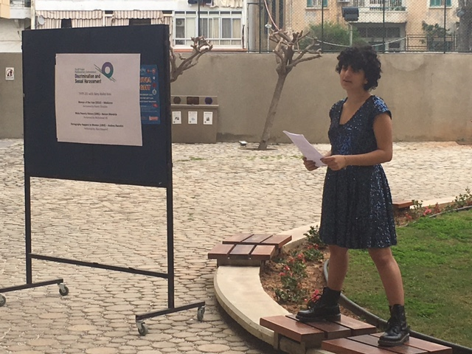
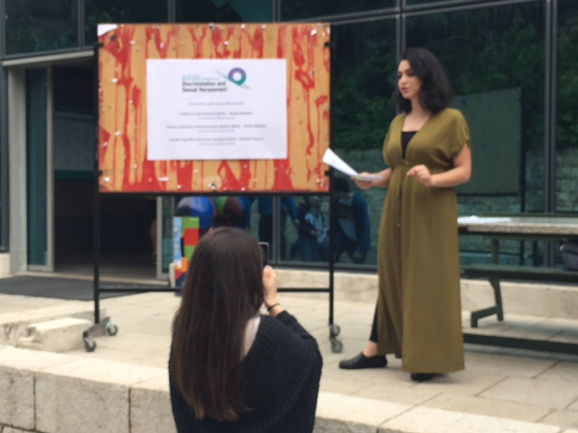

Slide 16
Joining efforts across boundaries to create common efforts of knowledge sharing and actions for change
There is hope and power through building
multisector- multidisciplinary communities
Building networks to create common spaces for knowledge exchange and shared actions for change
Notes:
Some join our conversation!

Slide 17
THANK YOU
شكراً

Slide 18
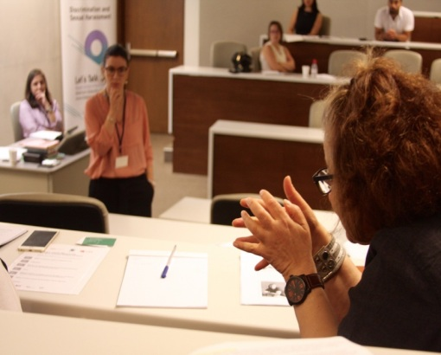
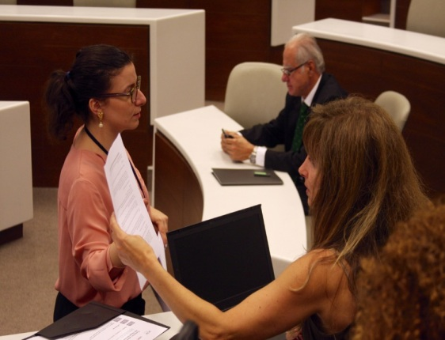

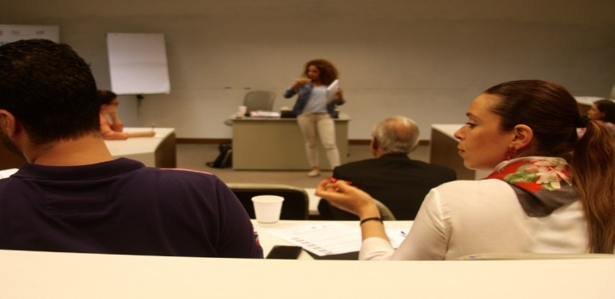

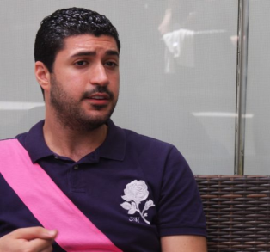
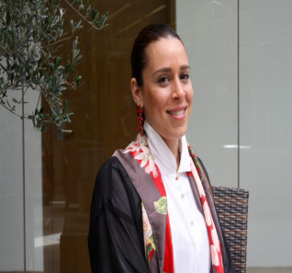
Testimonials from SME Training
“How to draft the policy, what does it contain, maybe the mechanism of reporting such an incident, the channel of communication regarding that, and the concept of the awareness that we need to raise as an HR to our employees, that it’s not wrong if such things happen in the workplace, that you can get back to us and report incidents.”
“It is the duty of the employer to introduce the topic of sexual harassment and inform employees about their duties and their rights. A healthy and equal workplace culture is vital for the growing success of any business and professional relationship..”
Farah Bousaleh
HR Manager
Maher Choueiry
Learning and Development Specialist
Notes:
Private sector involvement

Slide 19
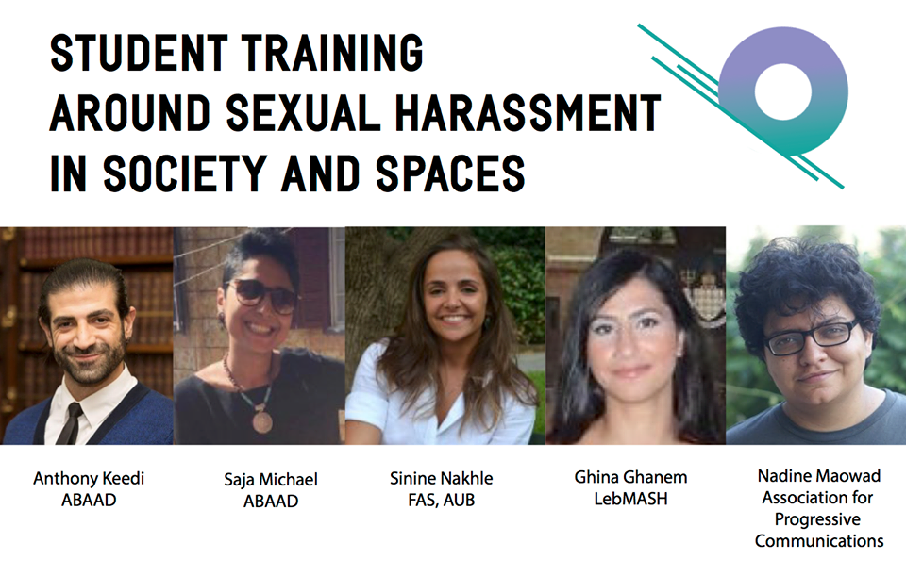
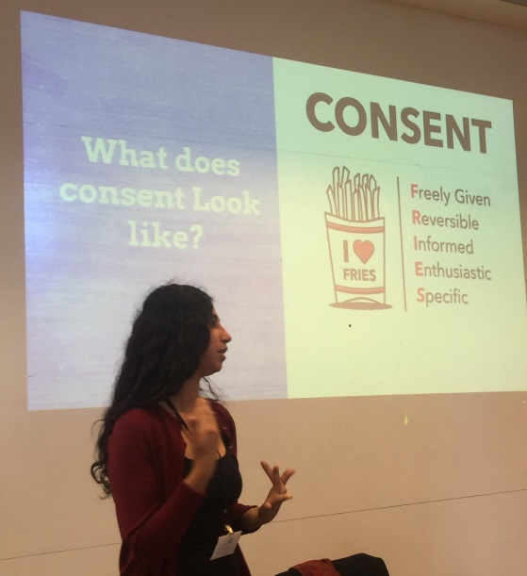
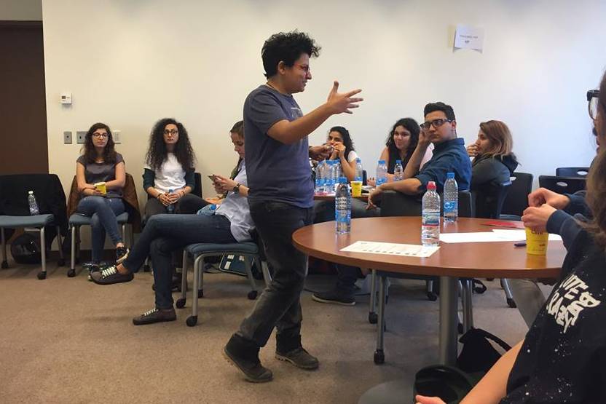
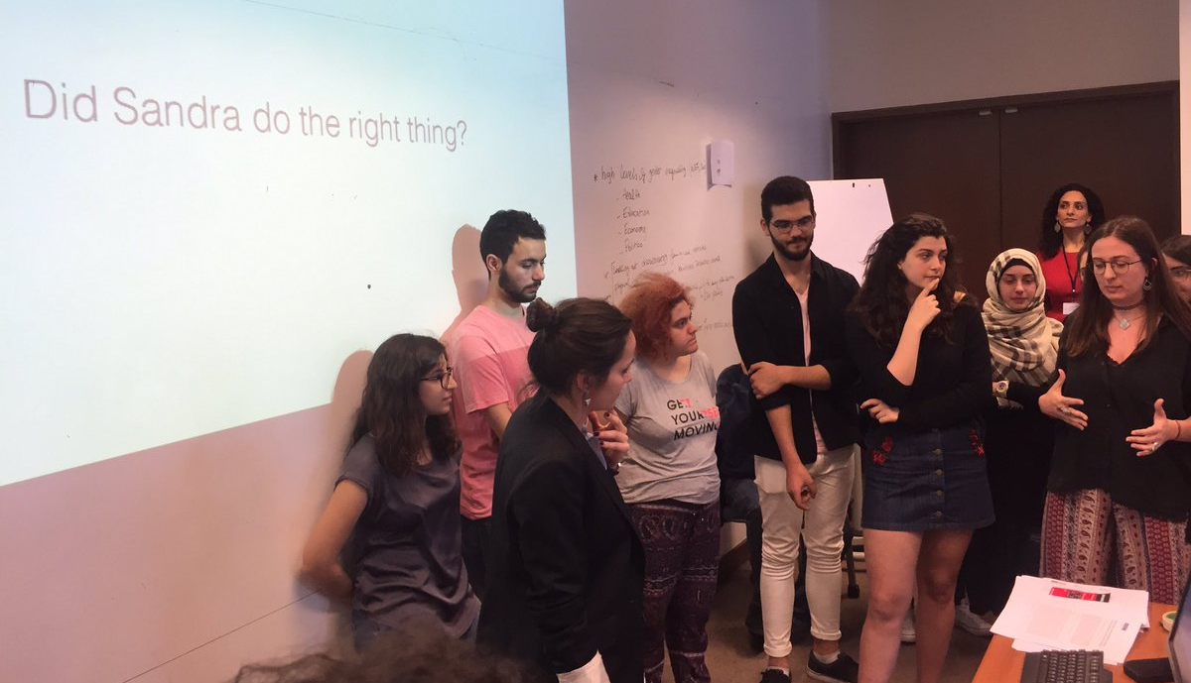
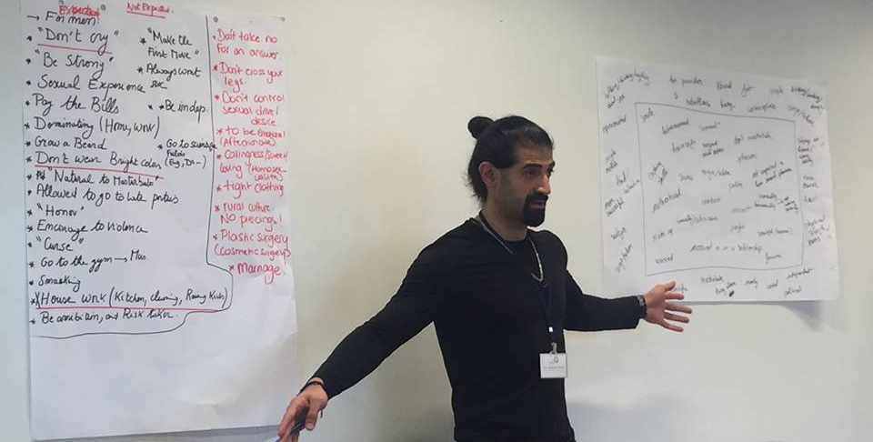
Student Training Day
Notes:
Student community beyond the AUB

