Slide 1
The KIP Project
The Breadth and Impact of the Mesh_Basita Campaign
#مش_بسيطة

Slide 2
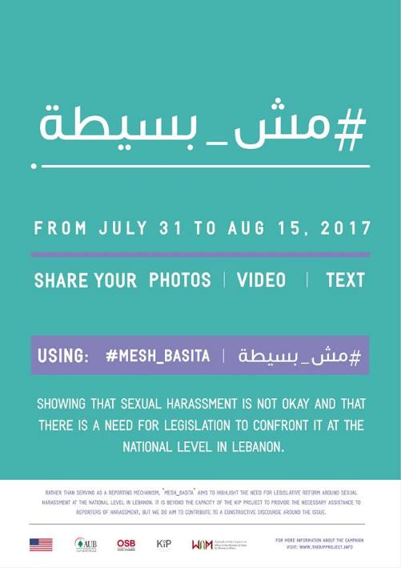

Slide 3
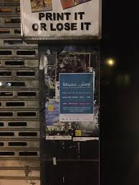
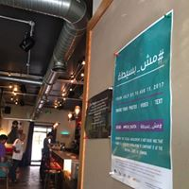
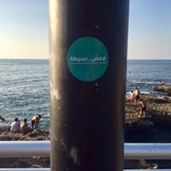
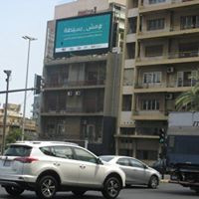

Slide 4
Capitalizing on the conference…
Sandriane Ayoub
Stephanie Khalil
NDU undergraduate graphic design student volunteers
Nour Massalkhi
AUB undergraduate Media Studies student internship, FAS

Slide 5
Spots across local channels…
The KIP Project's campaign #Mesh_Basita #مش_بسيطة stands for the idea that sexual harassment is not okay, that it should not be normalized, and that there should be legislative reform around these issues in Lebanon.
Rana Khoury for her creative consultation
Heyoka (Producer Daniel Habib, Director Mark Eid, Line Producer George Khalaf, D.O.P. Julien Kai, Camera Assistant Karim Akl, Sound Recordist Samer Maroun Matta, Wardrobe Stylist Valérie Yacoub) for their production of the videos
Danny Bou-Maroun for the music composition
Our actors, Natasha Choufani, Aya Abed, Jihane Diab, George Khalaf, Sany Abdul Baki, Ada Harb, Ihab Al Assaad, Joseph Risque D'Allah, Mahmoud Jaber, Samer Maroun Matta, Řèïna Hazouri, Jad Awad, Mary Ammoun

Slide 6
Augmenting the conversation…

Slide 7
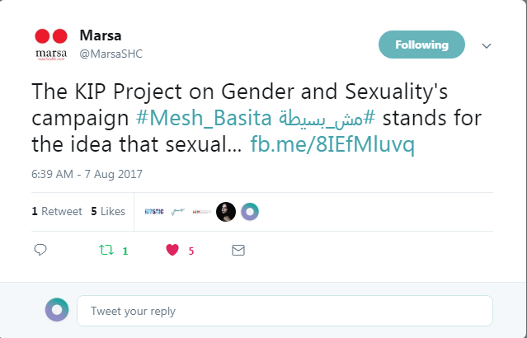
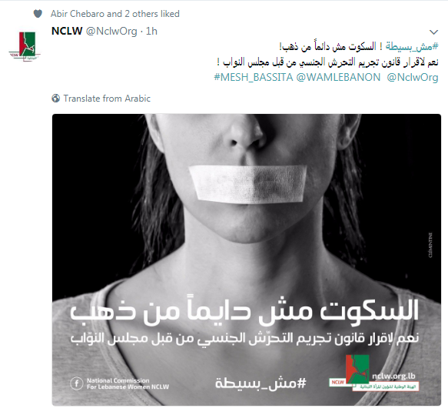
Notes:
Organizations

Slide 8
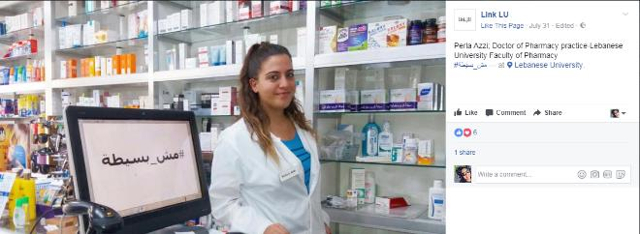
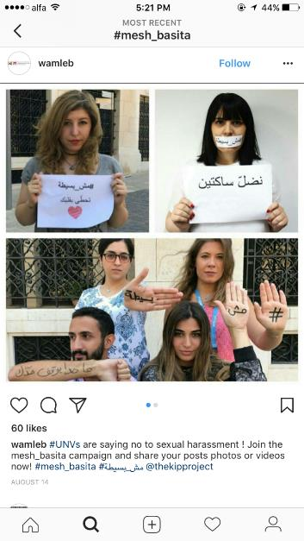
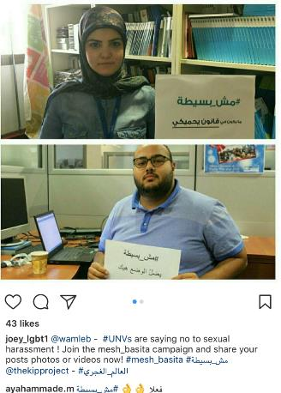
Notes:
Members of the general public

Slide 9
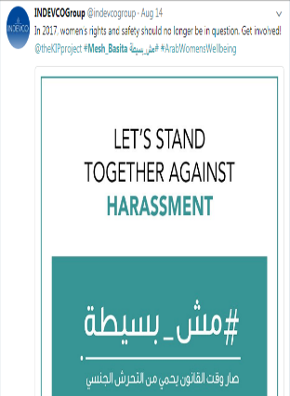
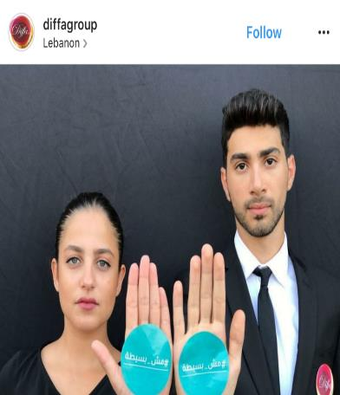
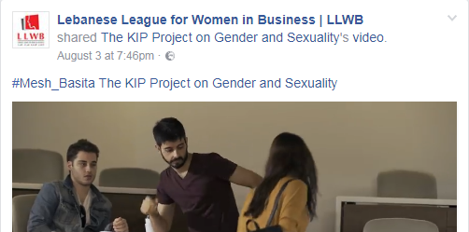
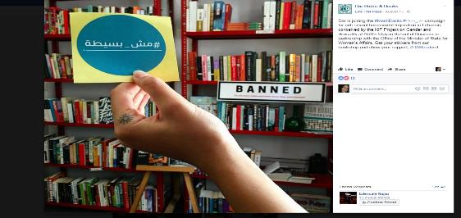
Notes:
Private Sector

Slide 10
Notes:
ABAAD Campaign

Slide 11
Building momentum …
Notes:
Partner….
Partnership with the Office of the Minister of State for Women's Affairs,WAMLebanon
----Minister Jean Ogassipian
----Mrs Abir Chebaro. Ministry of State for Women’s Affairs and Advisor to the Prime Minister on Women’s Affairs
Signs posters and print….

Slide 12
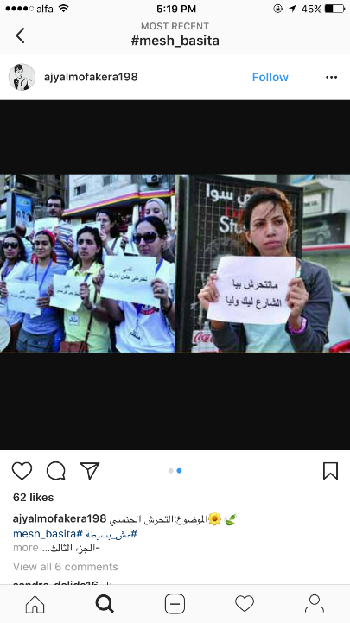
Notes:
International participation

Slide 13
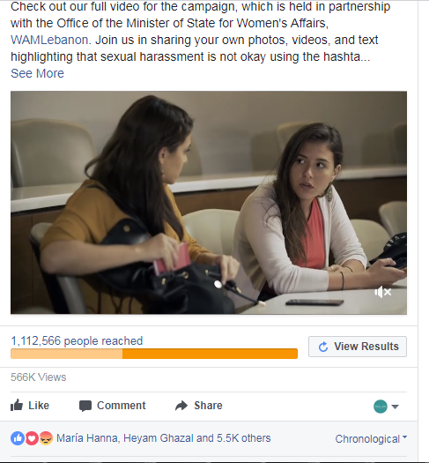

Slide 14
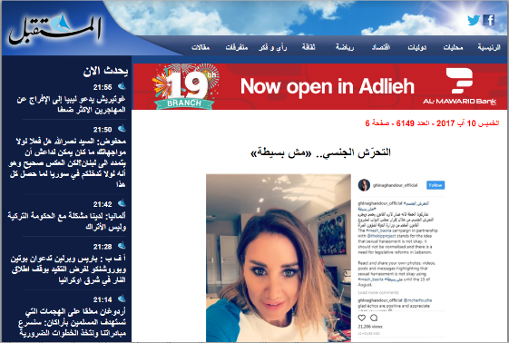
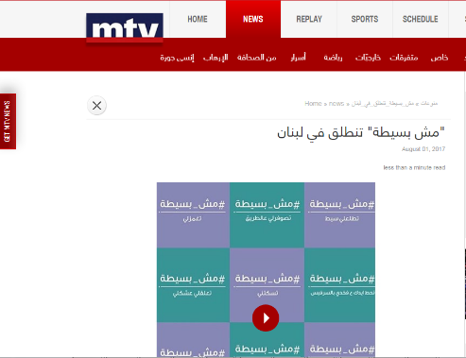
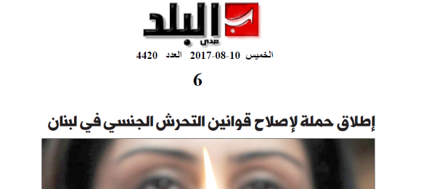
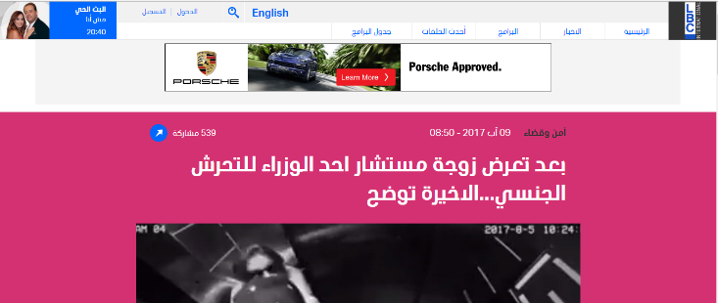

Slide 16
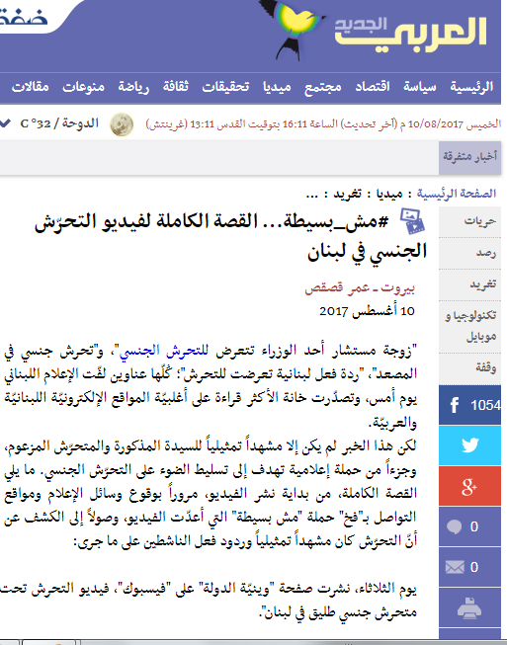
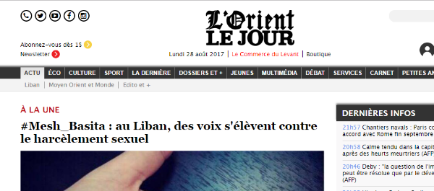
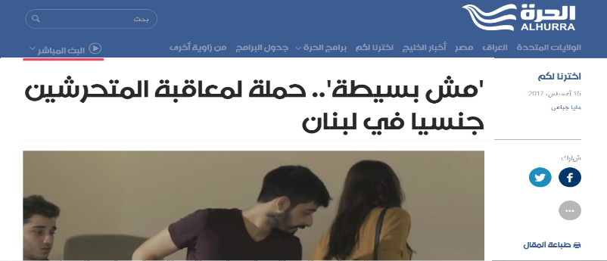

Slide 17
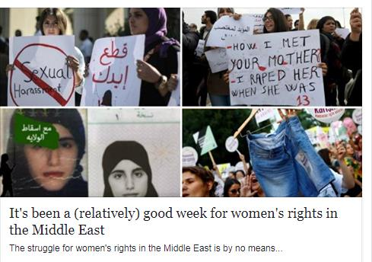
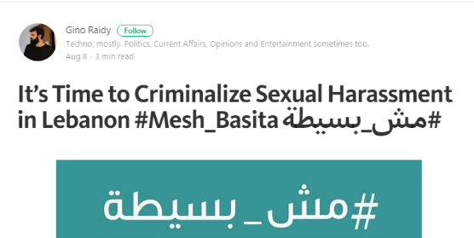
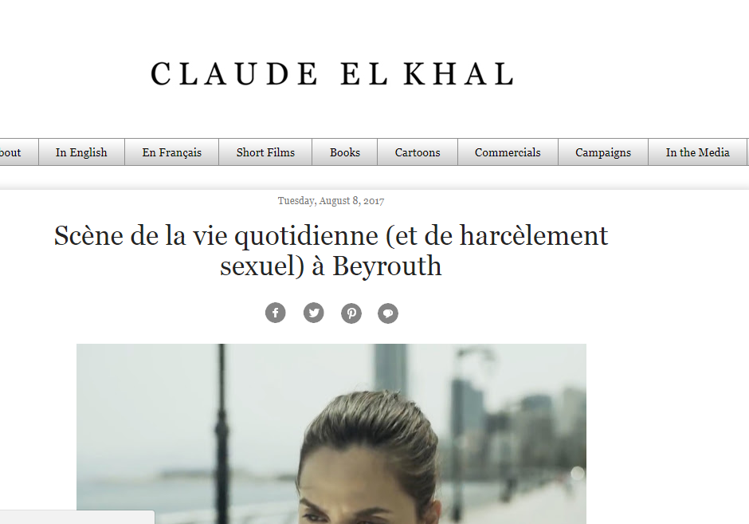
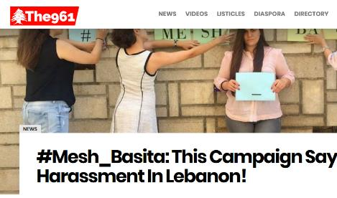

Slide 18
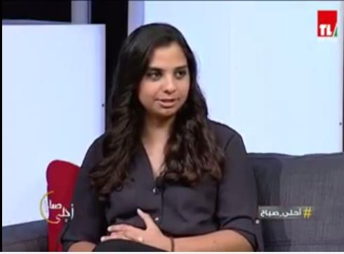
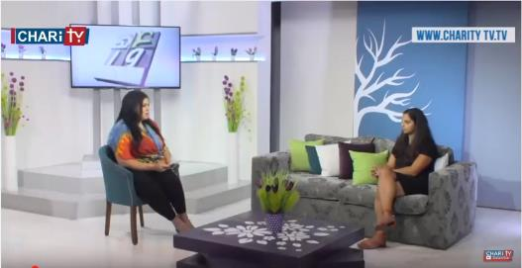
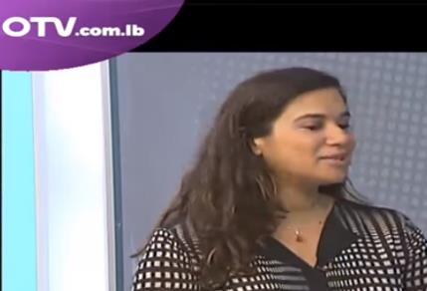

Slide 19
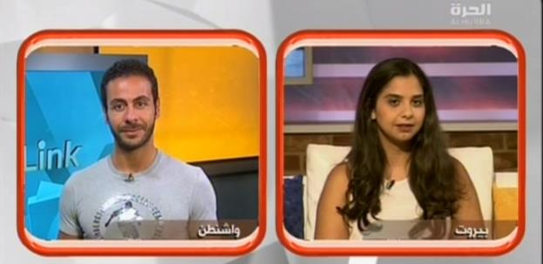
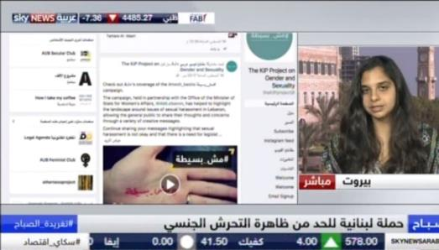
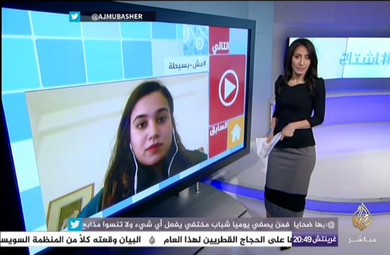

Slide 20
THANK YOU
شكراً

